Slide 1



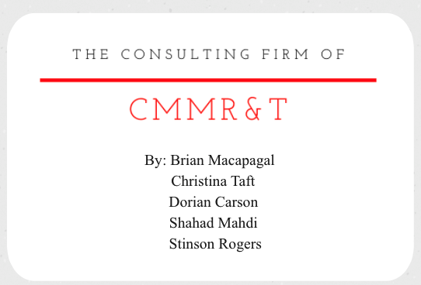

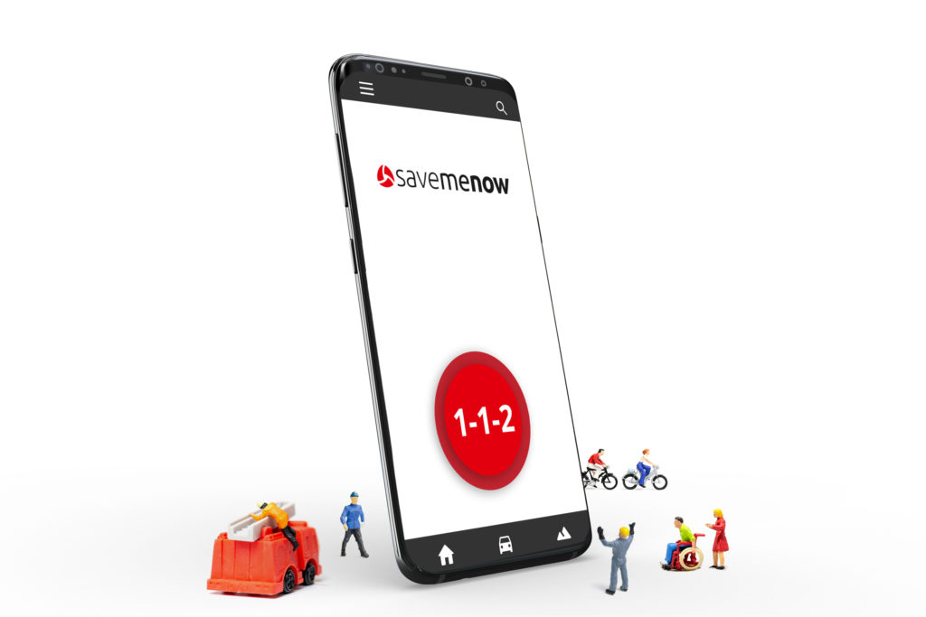


CMMR&T
business case for

Slide 2
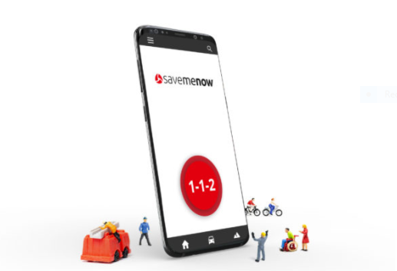
About SaveMeNow
SaveMeNow is an application that connects mobile devices quickly and efficiently with the closest emergency fire rescue service.
Currently SaveMeNow is in the UK and Europe.
The SaveMeNow application was developed for Android devices only
CMMR&T

Slide 3


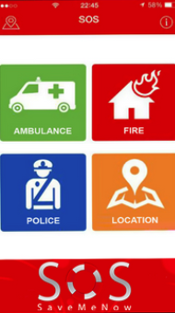
How it works
In the event of an incident, SaveMeNow sends data in real-time manually or automatically, to the nearest 999 centres.
The application allows the intervention team to have updated but limited data.
The services provided are:
in the event of a personal emergency, connecting you to the emergency service
in the event of an emergency near you, they will notify you
all of these service are provided manually or automatically thru the application
CMMR&T

Slide 4


Real time
Tracking GPS
The technology which we are introducing is an addition to an existing application which will allow first responders to be tracked, notified, and dispatched to a given location in real time.
The technology itself already exist.
Partner with Google ($8k/ year for 1,000 mobile devices)
The app connects to the emergency feature already on your phone which will allow you manually or automatically connect you to emergency dispatchers
Our mission is to provide a system that incorporates AI to utilize the current features of today’s phone.
CMMR&T

Slide 5

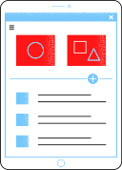
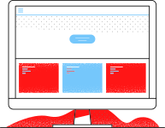



Organizational Setting and IT Function
Reduce emergency response time by 2% over 3 years
In 2018 average response time in Europe was 7 minute 47 seconds
1 minute and 10 of vicinity time
Reshape how emergency dispatcher track first responders
Track by phone instead of vehicle GPS
Real time location data and increase safety
** Will save departments $300k over 3 years**
CMMR&T

Slide 6
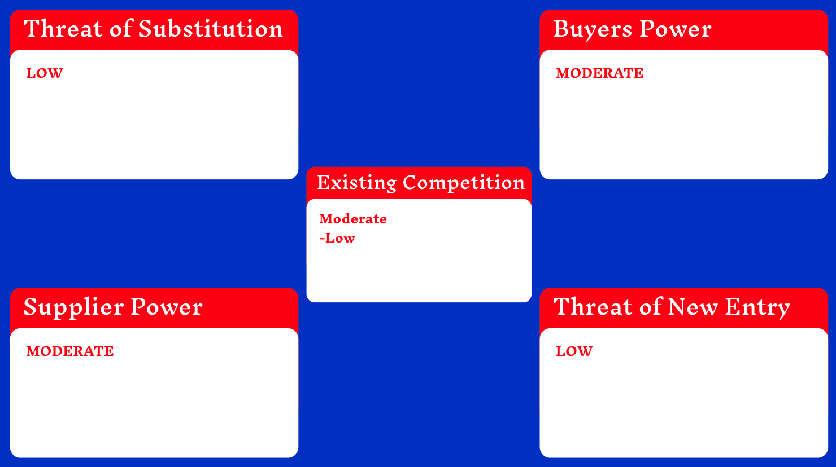
Traditional forms of rescue (via phone) are readily available, however SaveMeNow have disruption properties to replace traditional forms of rescue communication.
No direct substitution
-Wide customer base
-Platform livelihood depends on buyers
- Buyers adaptation is a success factor.
-112 Accessible, My112, 911, and -RapidSOS
BrightAct
Legal Authorization
- Capital Requirements
- Motivation to provide services (non commercial)
- Established infrastructure with emergency responders
-Third party risks
+ Data security
+ Service quality
+ Service inconsistency
+ Failure risks

Slide 7

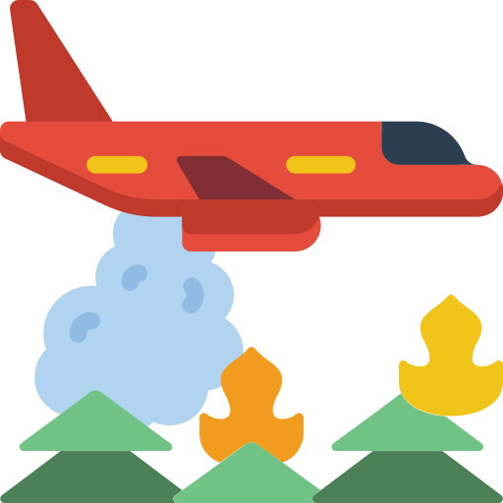

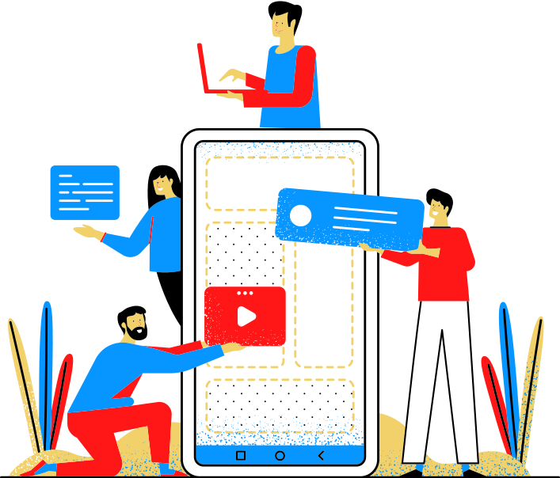



Competitive Position
Global First-Mover
First Globally with Real-Time Data, victim-centering, watching rescue, sensors, and photos sent to 112 centres
112 Accessible, My112, 911, RapidSOS, Telefonica
Not as comprehensive without data-collecting, photos,
knowing when help arriving, sensors, situation awareness
CMMR&T
AccesSOS NENA: text & translation not linked to 911
Our MVP2 would include disability access, translation, text
BrightAct EU - distribution, reporting, not ASAP rescue
First-Mover Accepted - MVP1 acceptd by entities/govts,
fire departments, 112. Ready to expand after Beta testing
in Spain, UK, Australia, Turkey, and hopefully the USA

Slide 8


Justification
SaveMeNow
Although competition such as 112 Accesible add geolocation, basic incident-type manual selections, and contact-related data added before an emergency, these are mainly add-ons rather than enhancements to accuracy, which would not significantly save lives or give automation during confusion (Telefonica, 2020).
No deterrence. Buttons do not aid enough.
Situation awareness is needed and connecting victims effectively to responders which real-time watching of your rescue, data, and sensors will do with more accurately to remove errors, insecurity, and confusion faster.

Slide 9
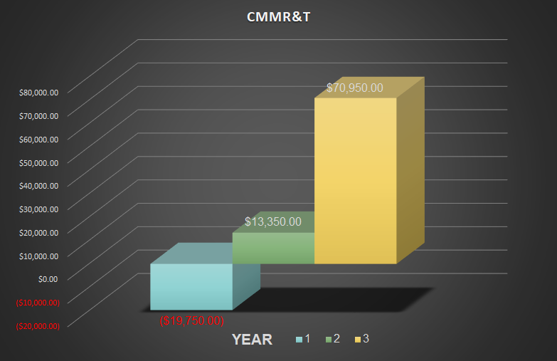
Financials
Rate of return
63.25% by year three.
Return on Investment
1.6 years / 19 months.
Incentivised commission
Increase client retention
Increase client acquisition
CMMR&T

Slide 10



Funding
Investment
$90,000: Tech Integration
6 Months - 1 Year
Tech development and testing
Year 1 to 3:
Tech Implementation
Year 3- 5:
Data Management & AI Management
Timelines
Development
Incorporation
Test
Modification
Implementation

Slide 11

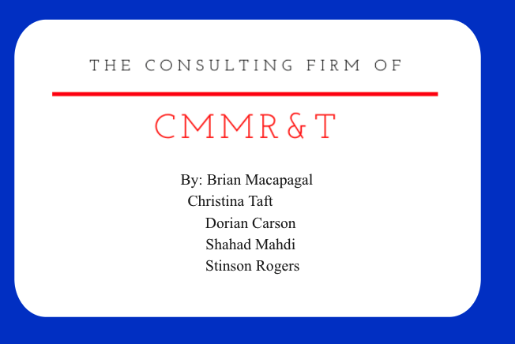
Thank you!
Questions?
CMMR&T

